Slide 1
Thesis Meeting 11
Tuesday 10/04/2018

Slide 2
Agenda
New LES simulations (preliminary results)
LES superposition

Slide 3
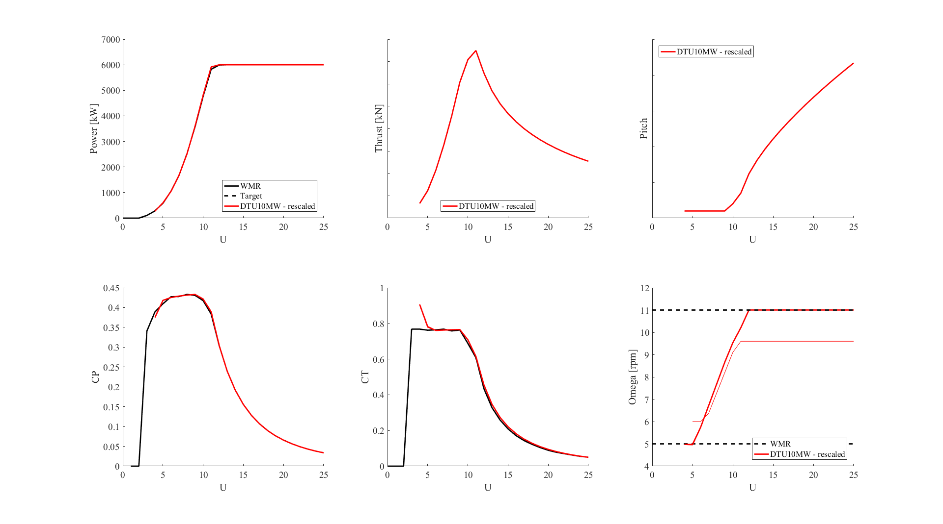
1a. LES Wind turbine
Notes:
DTU10MW turbine scaled (red) to WMR wind turbine (black): matches very close

Slide 4
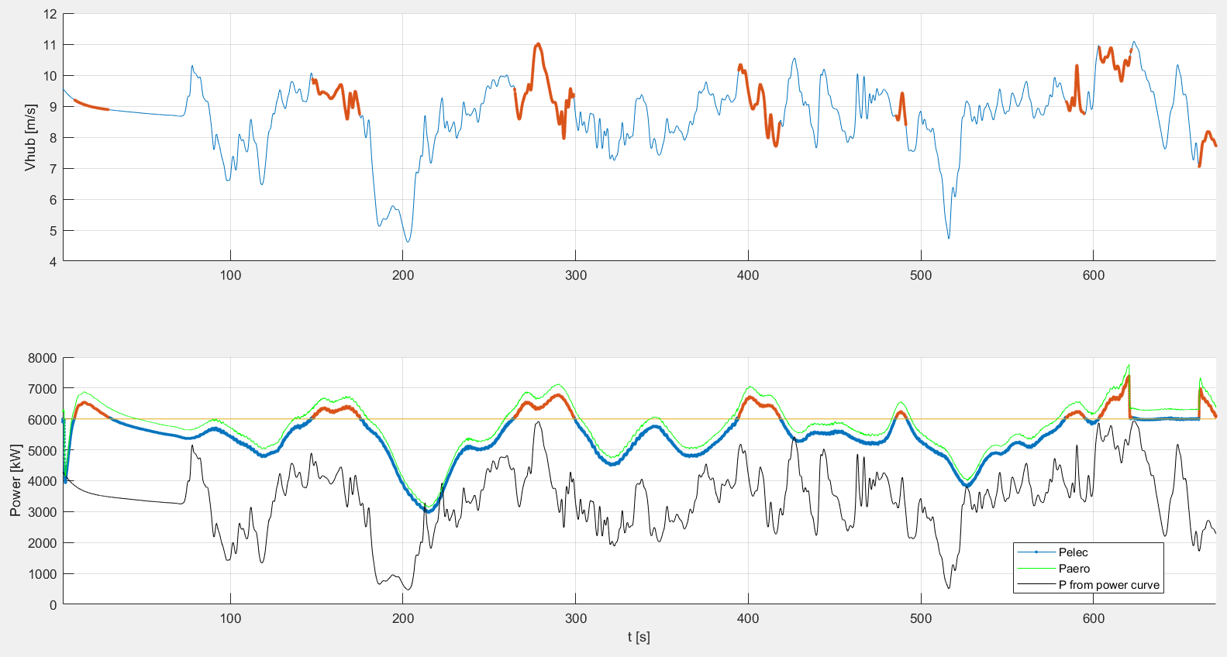
1. New LES simulations (preliminary results)

Slide 5
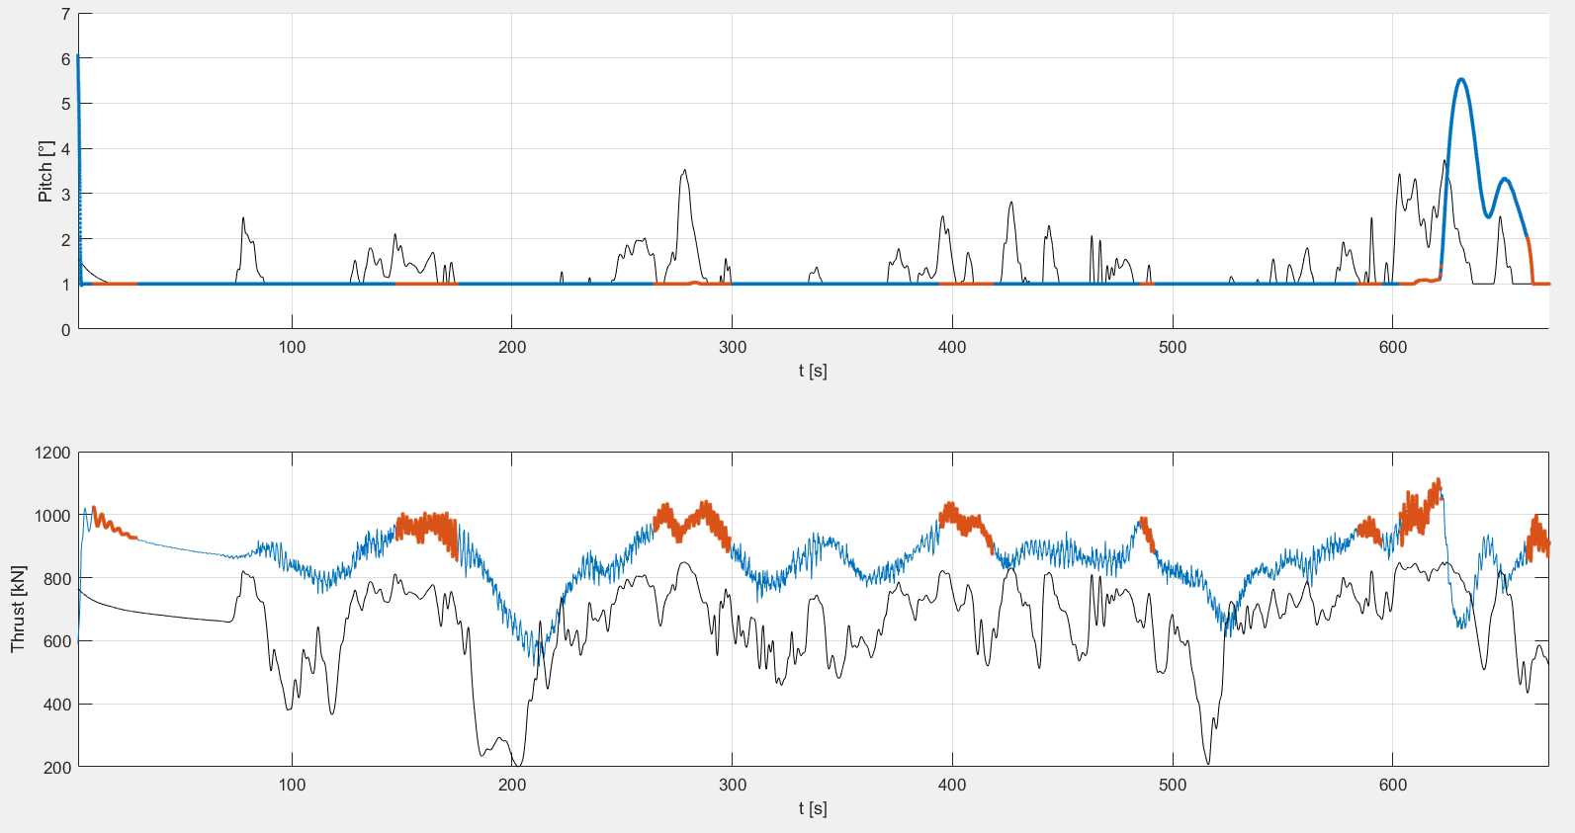
1. New LES simulations (preliminary results)

Slide 6
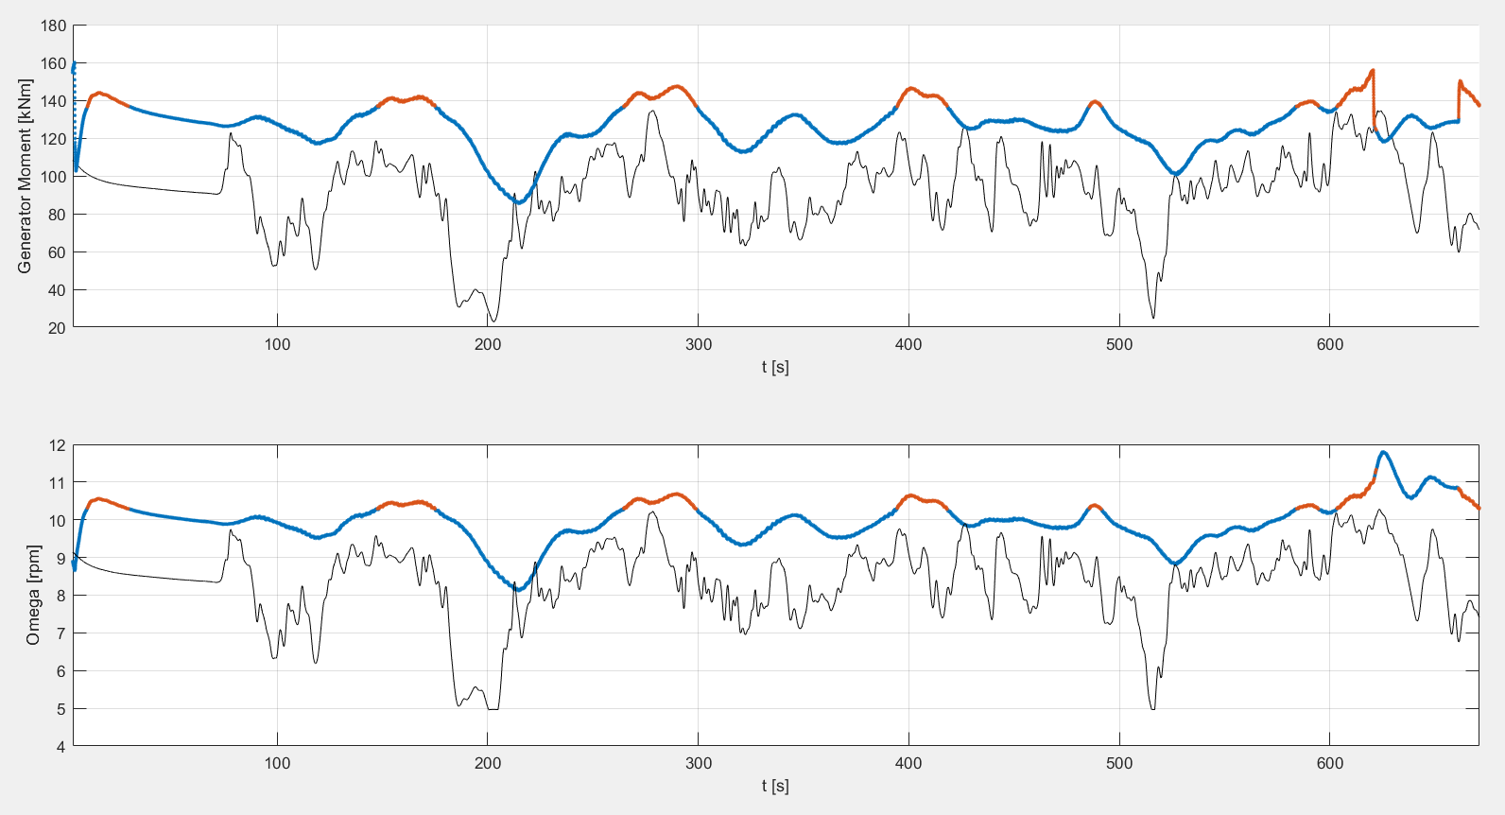
1. New LES simulations (preliminary results)

Slide 7
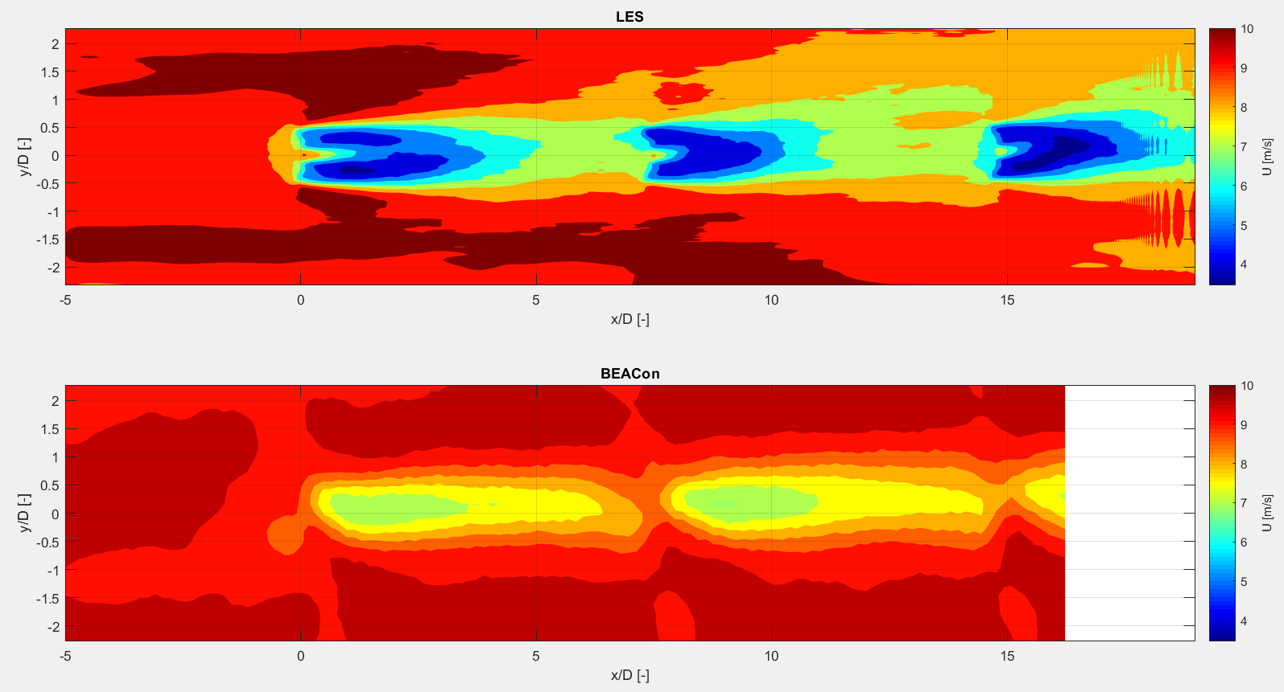
Mean wind speed at 100 m
1. New LES simulations (preliminary results)
LES results: total mean of data (not enough data to calculate the ensemble mean)

Slide 8
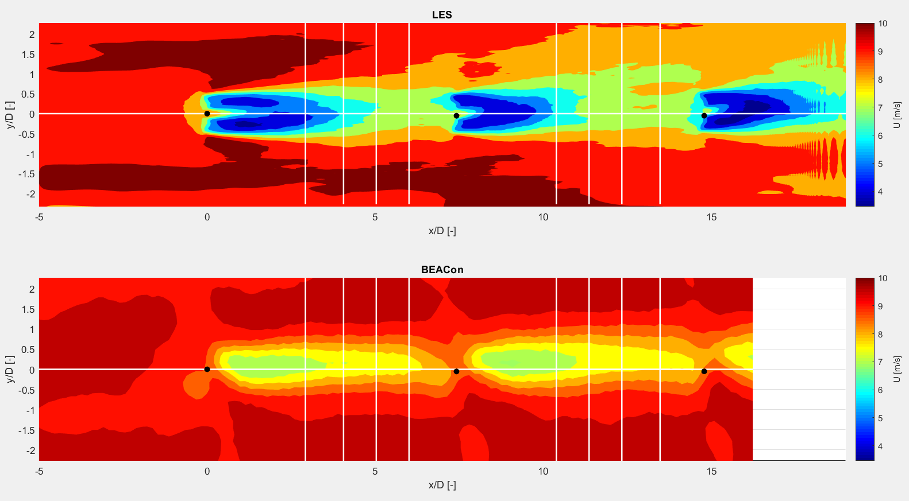
1. New LES simulations (preliminary results)
WT1 + ~3,4,5,6 D

Slide 9
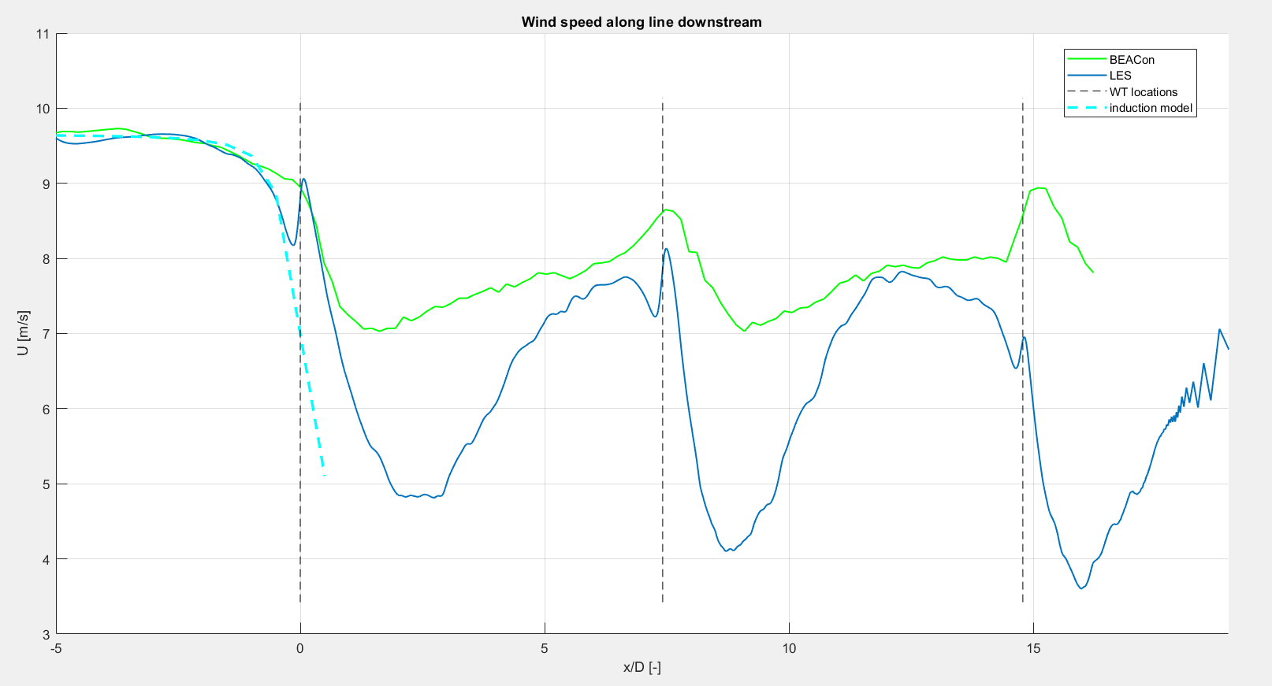
Mean wind speed at 100 m along line in streamwise direction
1. New LES simulations (preliminary results)
LES results: total mean of data (not enough data to calculate the ensemble mean)

Slide 10
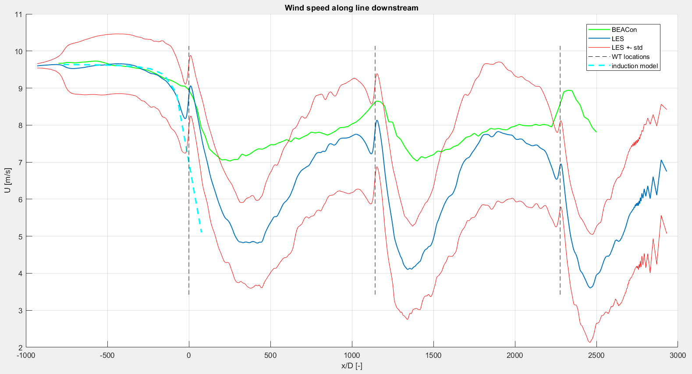
Mean wind speed (+-std) at 100 m along line in streamwise direction
1. New LES simulations (preliminary results)
LES results: total mean of data (not enough data to calculate the ensemble mean)

Slide 11
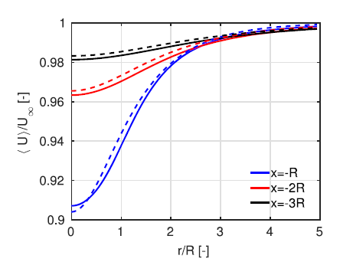
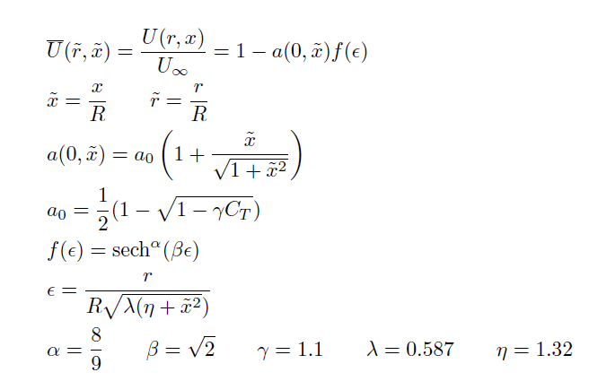
1+. Simple induction model
A simple model of the wind turbine induction zone derived from numerical simulations – N.Troldborg et al.

Slide 12
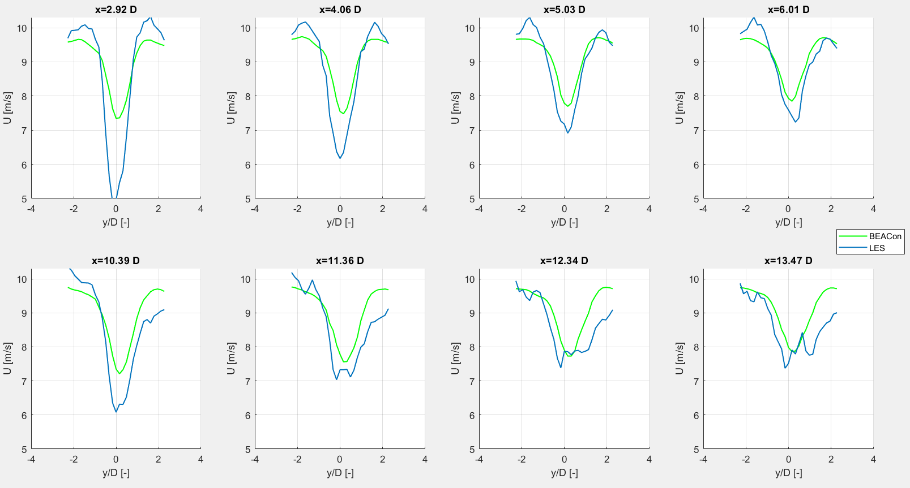
1. New LES simulations (preliminary results)
WT1 + ~3,4,5,6 D
WT2 + ~3,4,5,6 D
LES results: total mean of data (not enough data to calculate the ensemble mean)

Slide 13
1. New LES simulations (preliminary results)
Difference due to controller of LES wind turbine?
Or interpolate LES data in a different way?
Use inclined planes to extract LES data
Spatial averaging on inclined planes
Afterwards spatial average on Cartesian grid
Information from BEACon method needed
Inclided planes + grid points

Slide 14
2. LES Superposition
Single Wake
Superposition
Wake boundary

Slide 15
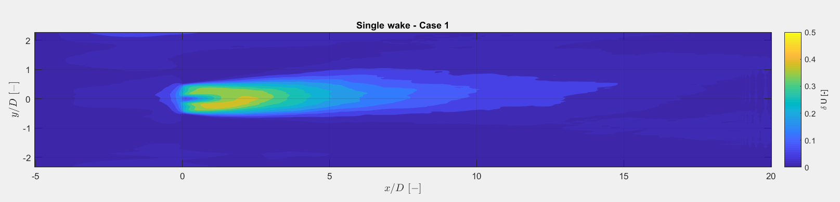
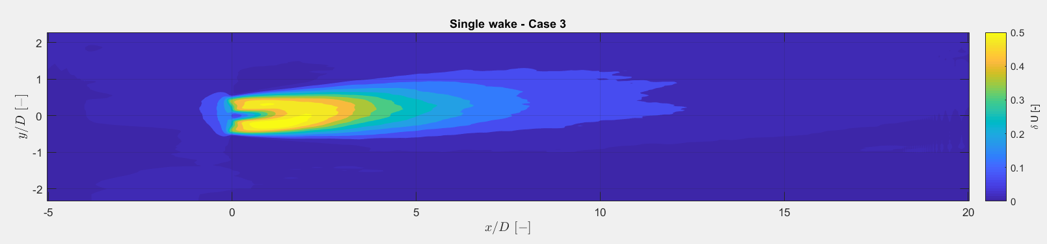
2. LES superposition (Single Wake)
Yaw error
Case 1: -1,06°
Yaw error Case 3: -0,52°

Slide 16
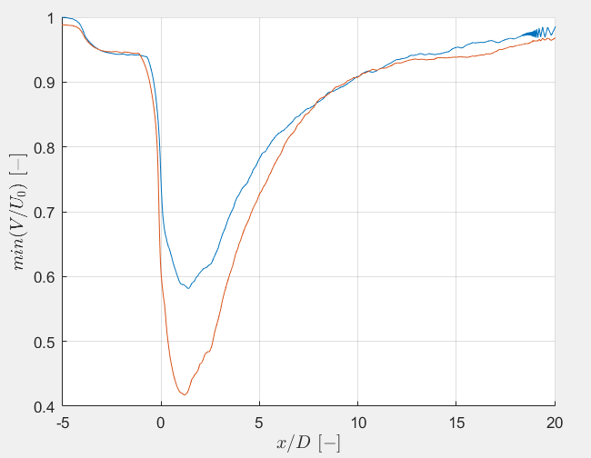
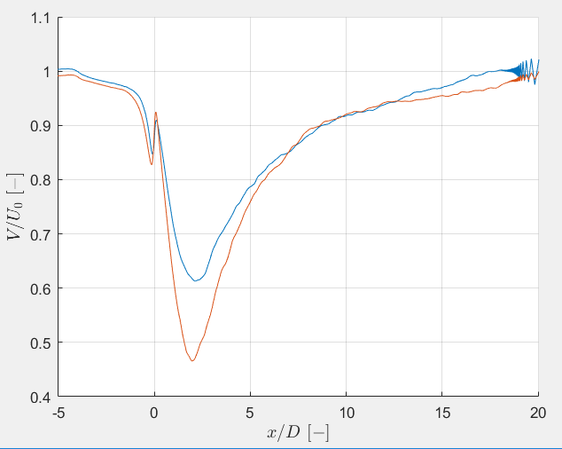
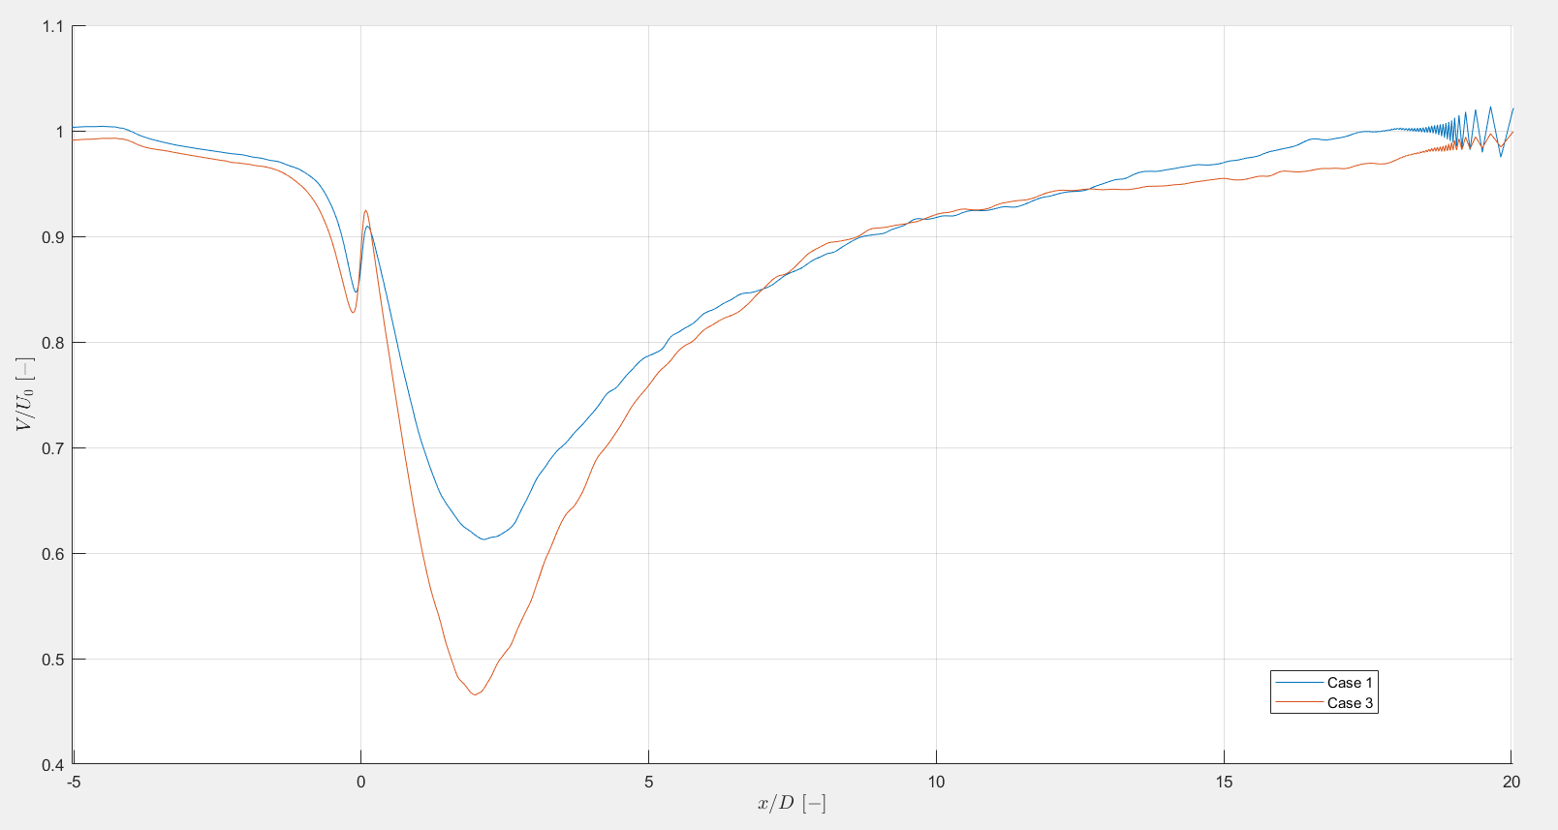
2. LES superposition (Single Wake)

Slide 17
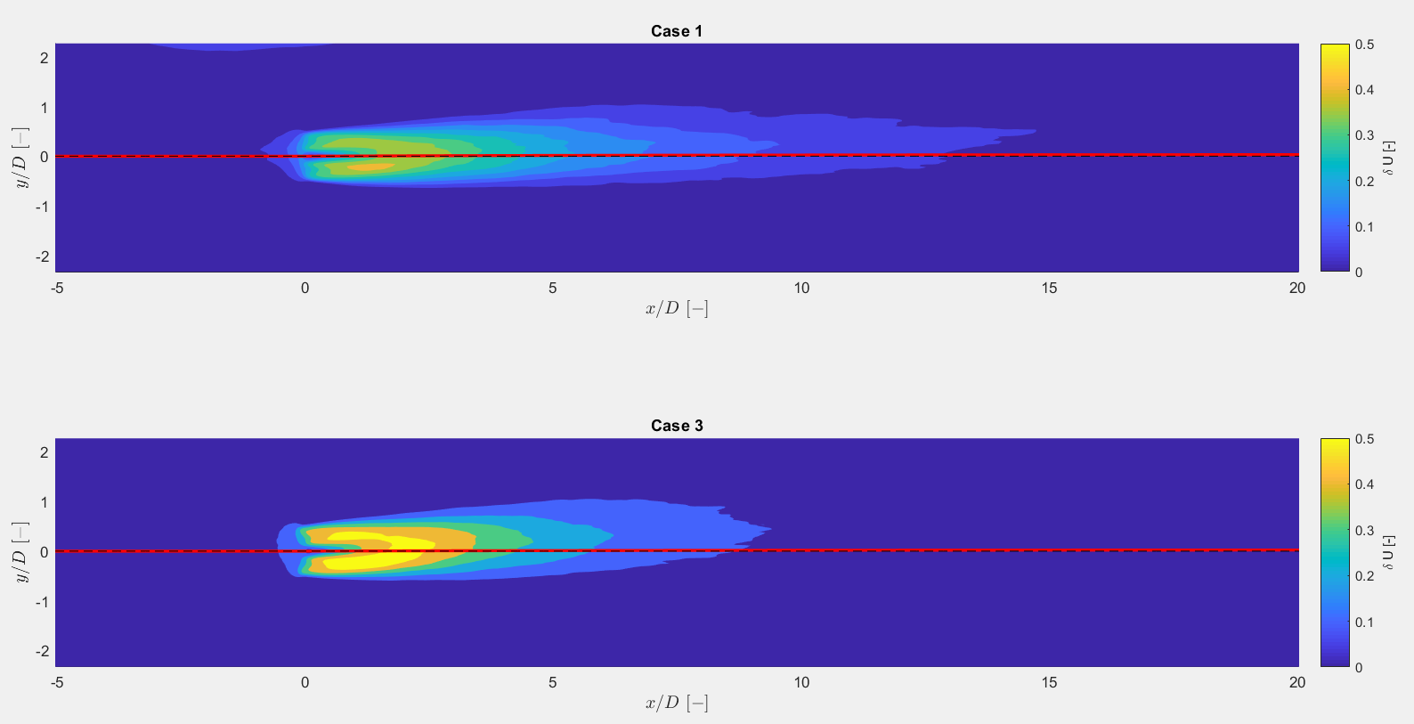
2. LES superposition (Single Wake)
Deflection of center line if
Yaw error
Case 1: -1,06°
Yaw error Case 3: -0,52°
Deflection of center line (Jiménez et al., Gebraad et al.)

Slide 18
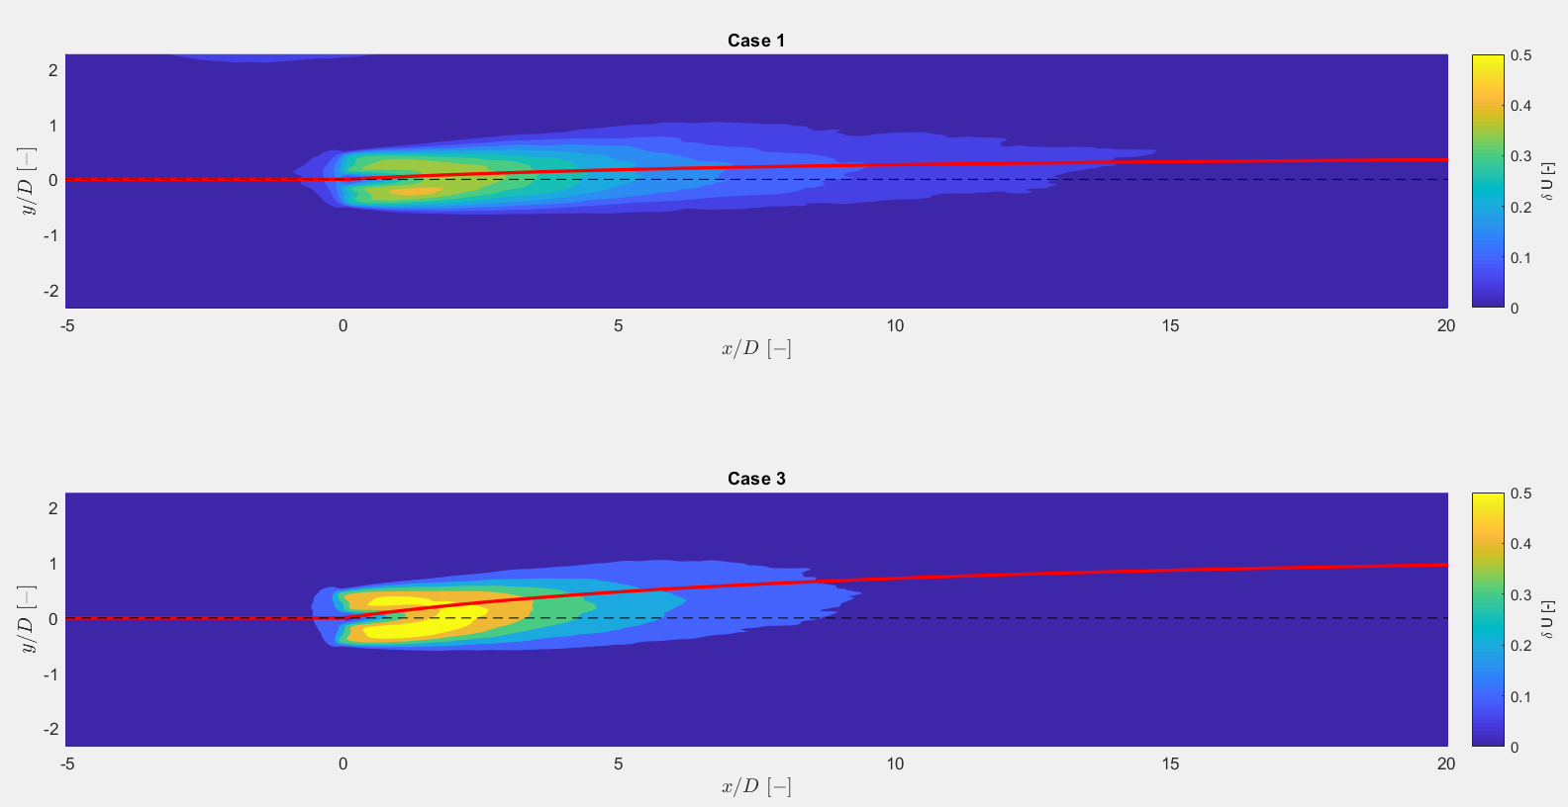
2. LES superposition (Single Wake)
Yaw error implemented in LES in degrees or radians?
Deflection of center line if
Yaw error
Case 1: -1,06 rad = -60,7°
Yaw error Case 3: -0,52 rad = -29,8°
Deflection of center line (Jiménez et al., Gebraad et al.)

Slide 20
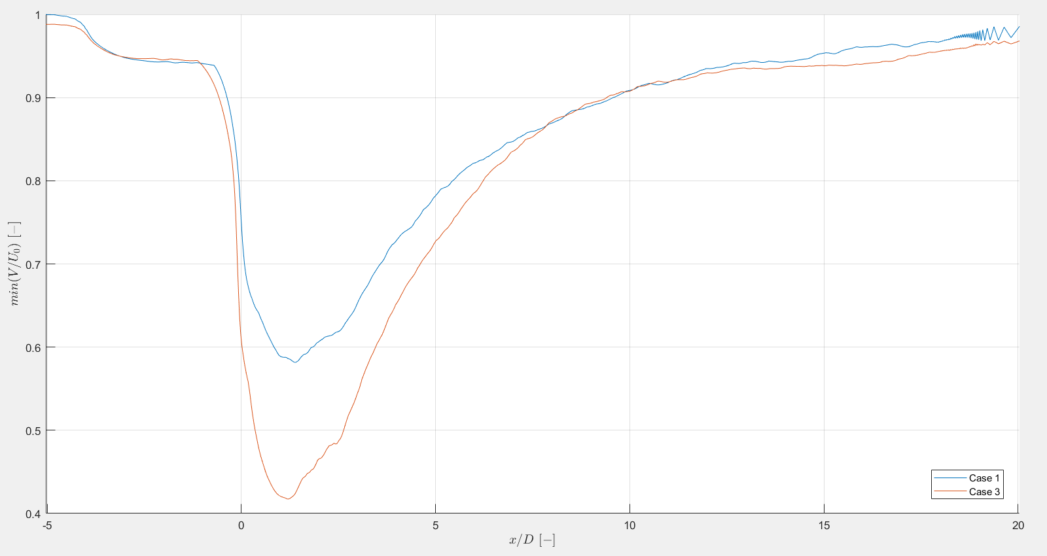

Slide 21
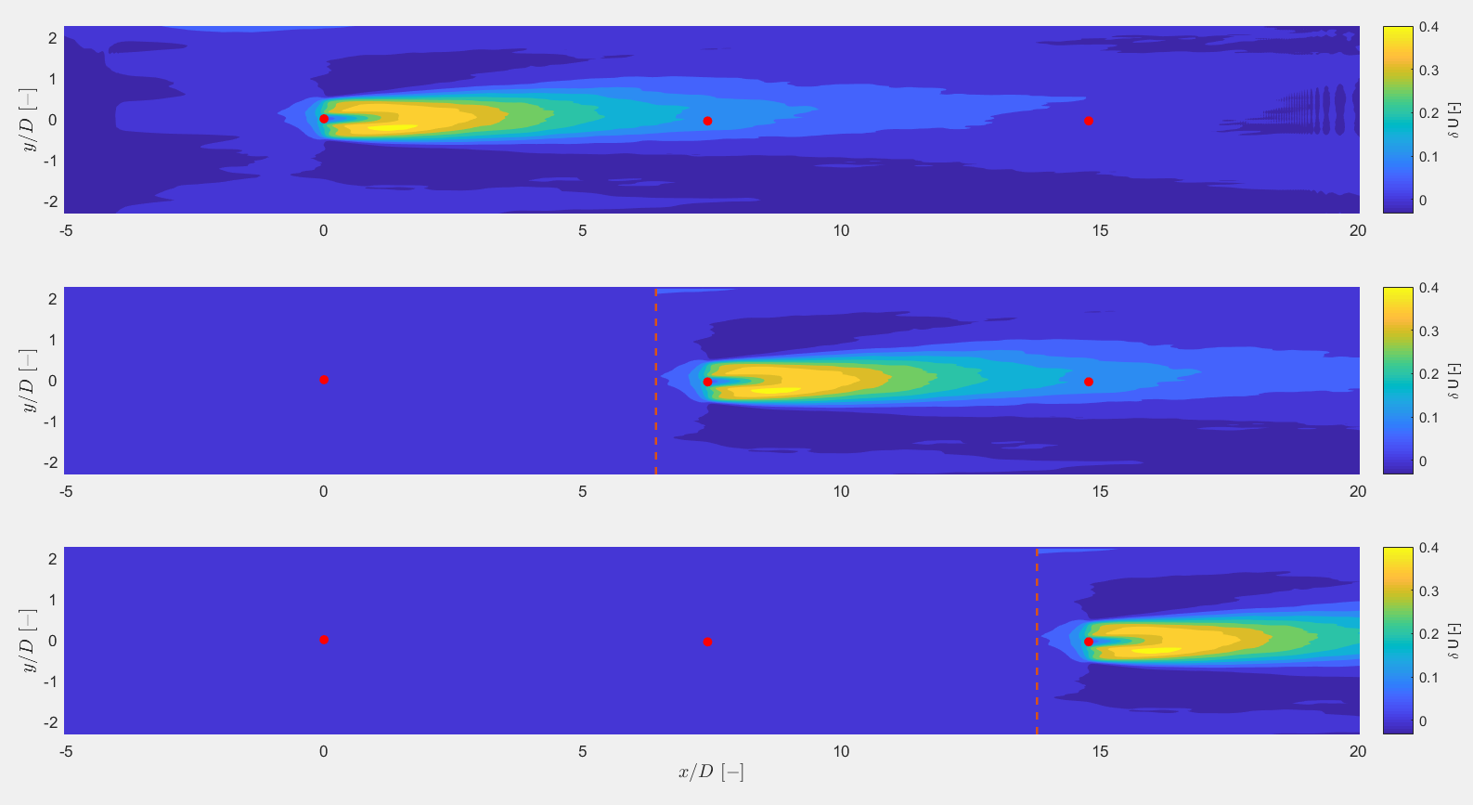
2. LES superposition (Case 1)

Slide 22
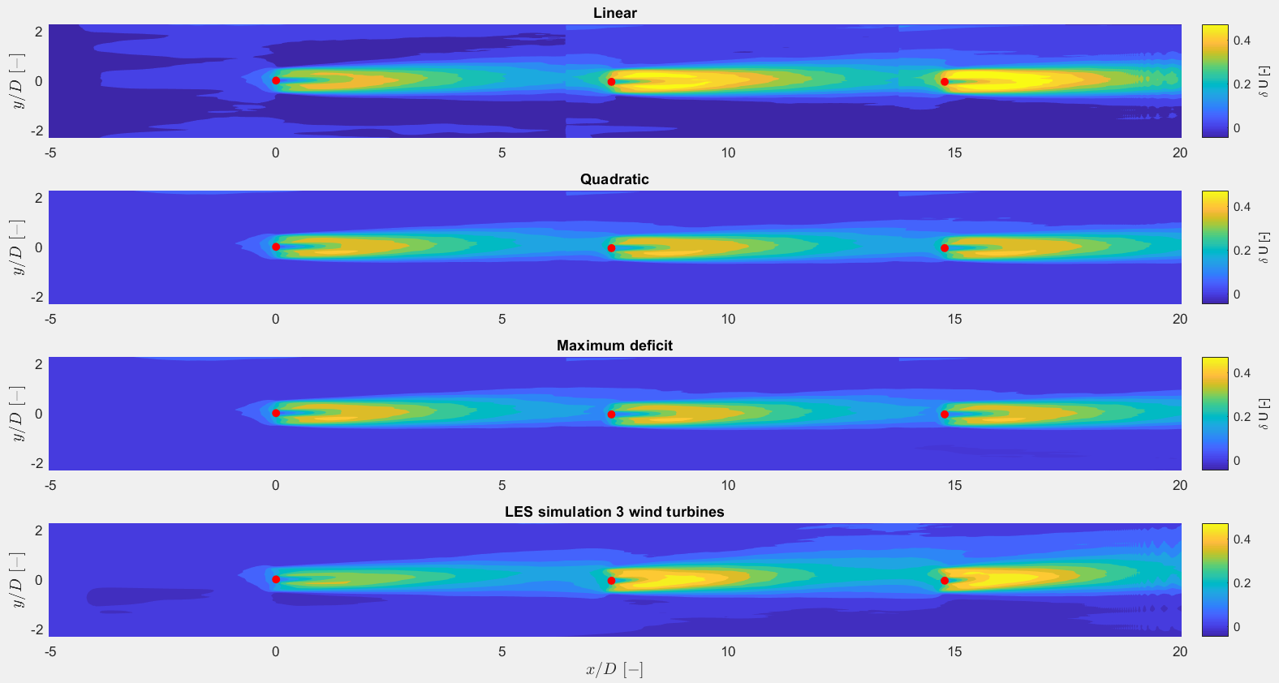
2. LES superposition (Case 1)

Slide 23
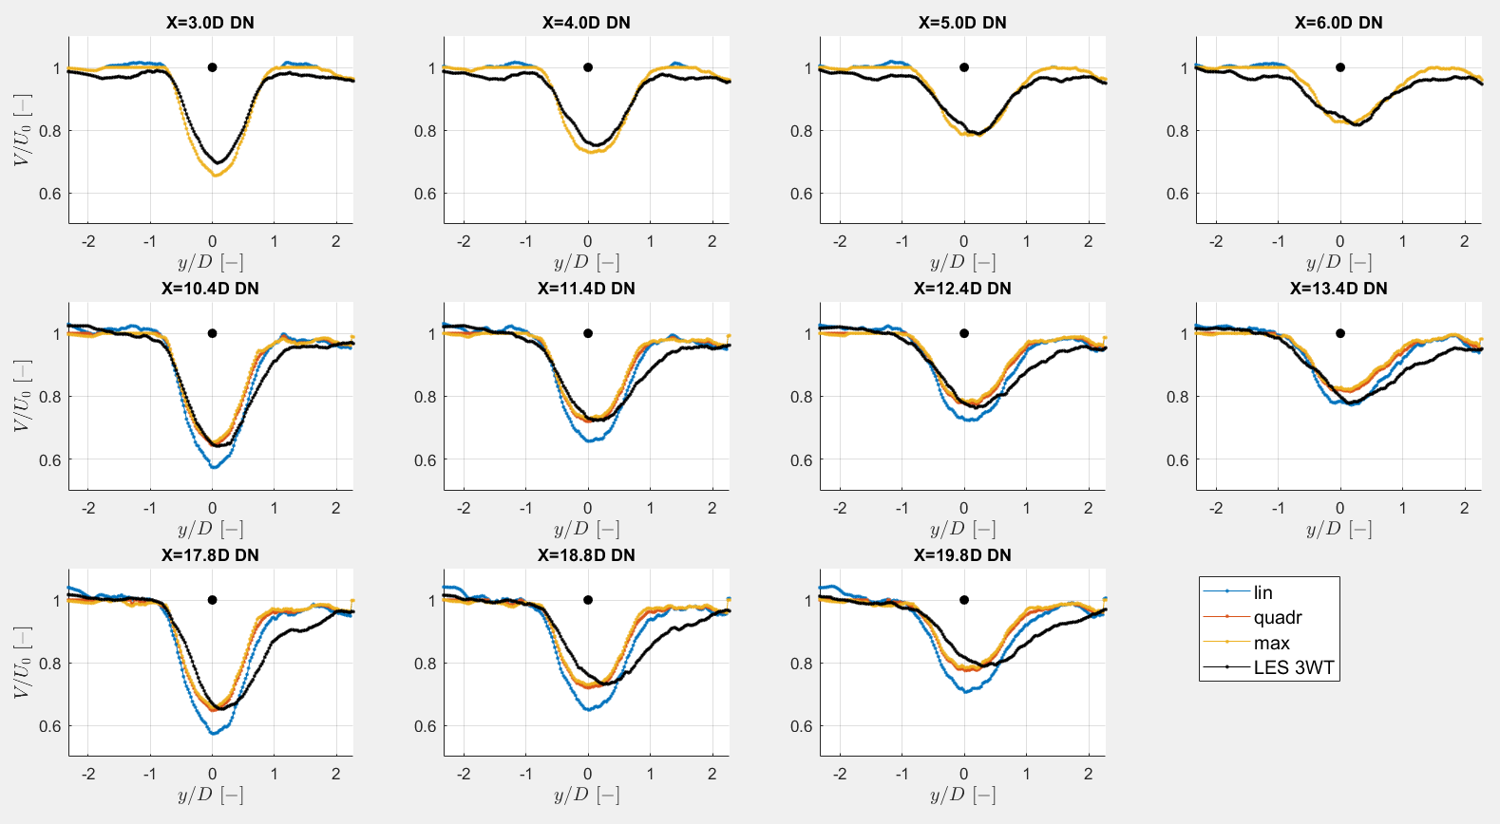
2. LES superposition (Case 1)

Slide 24
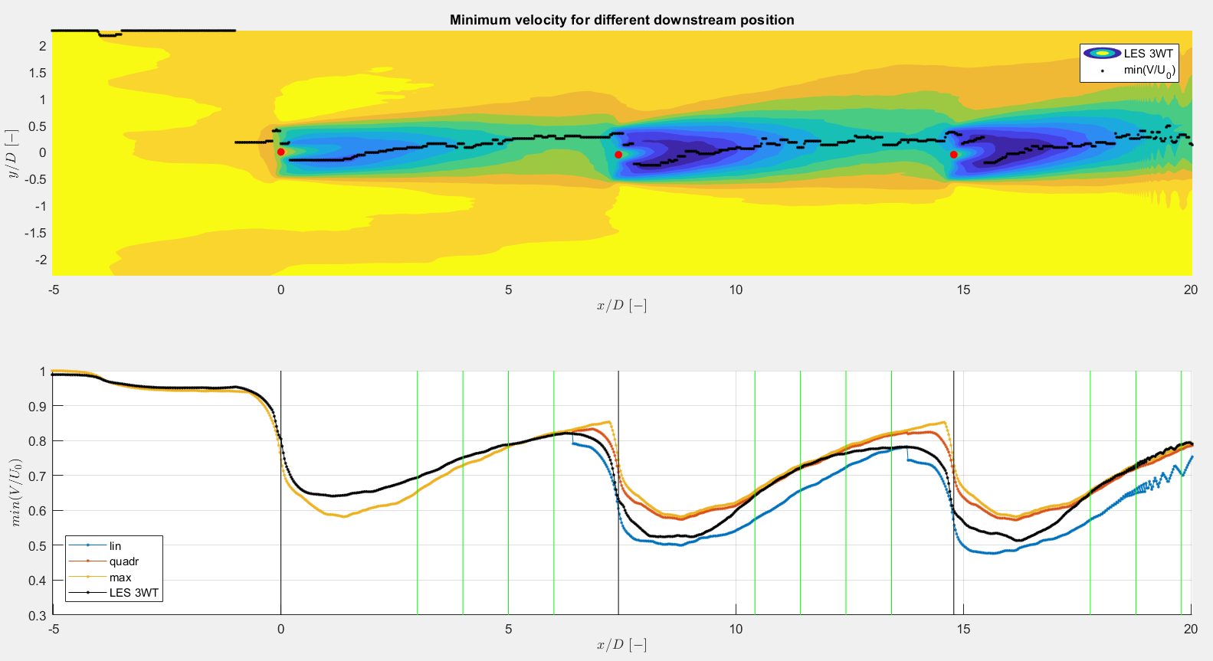
2. LES superposition (Case 1)

Slide 25
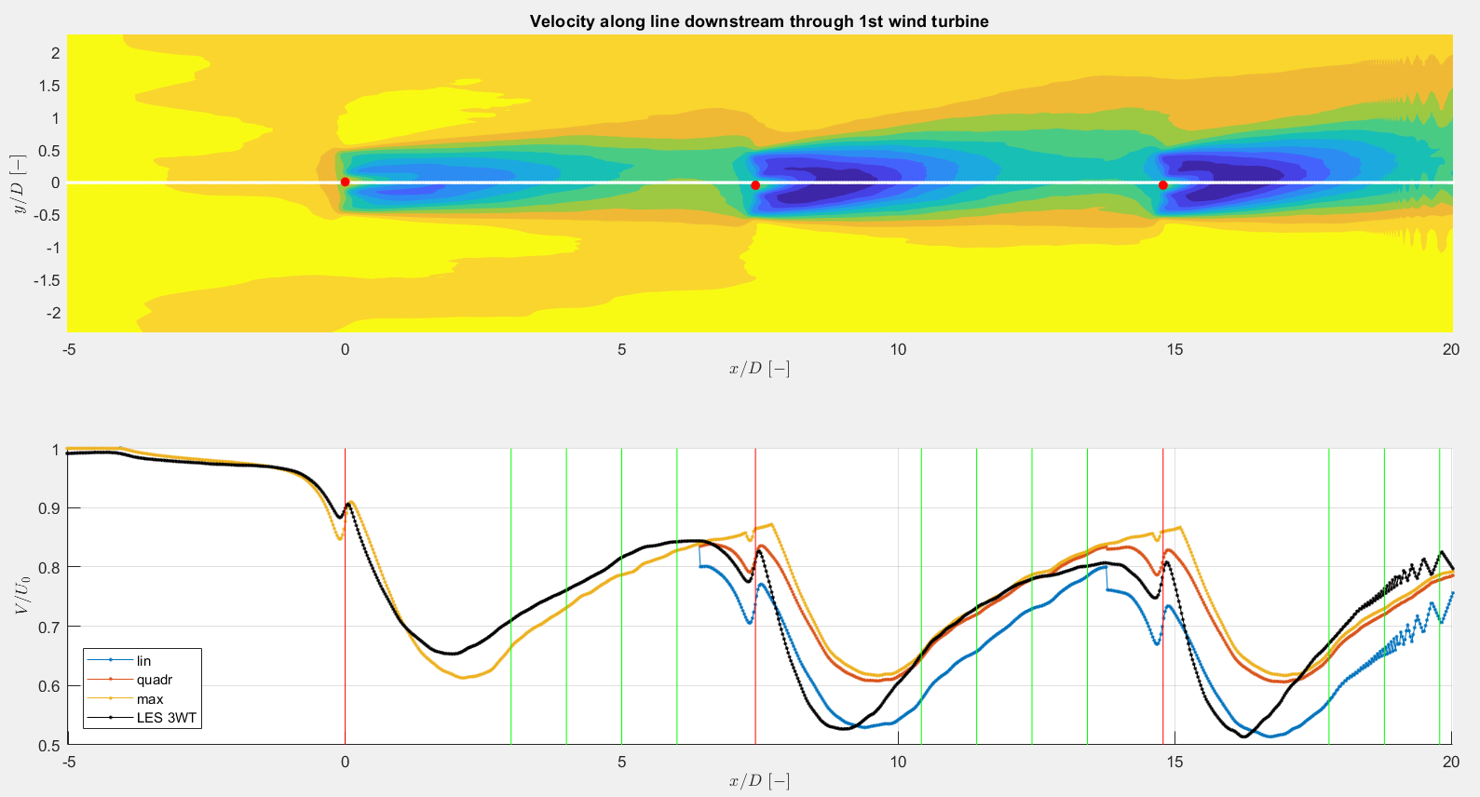
2. LES superposition (Case 1)

Slide 26
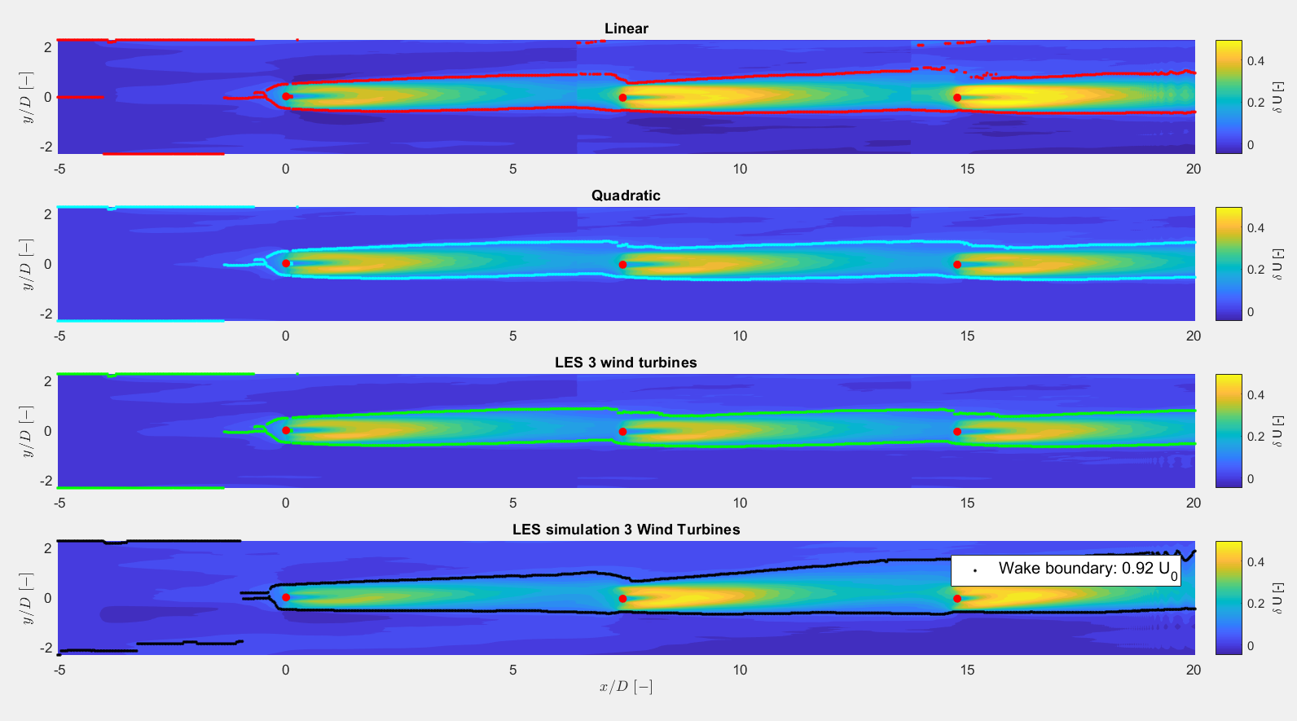
2. LES superposition (Case 1)

Slide 27
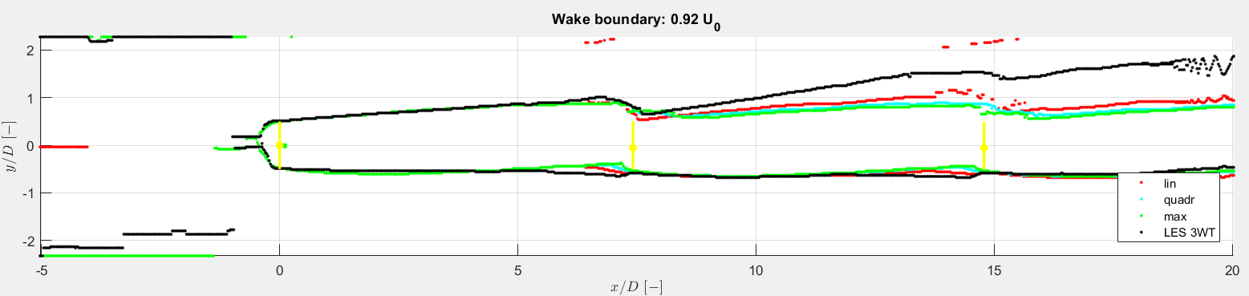
2. LES superposition (Case 1)

Slide 28
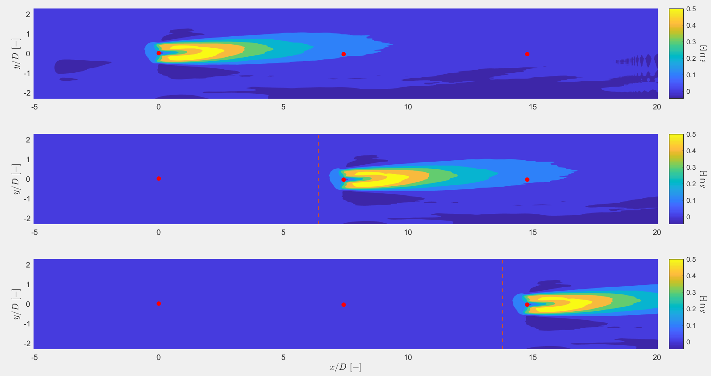
2. LES superposition (Case 3)

Slide 29
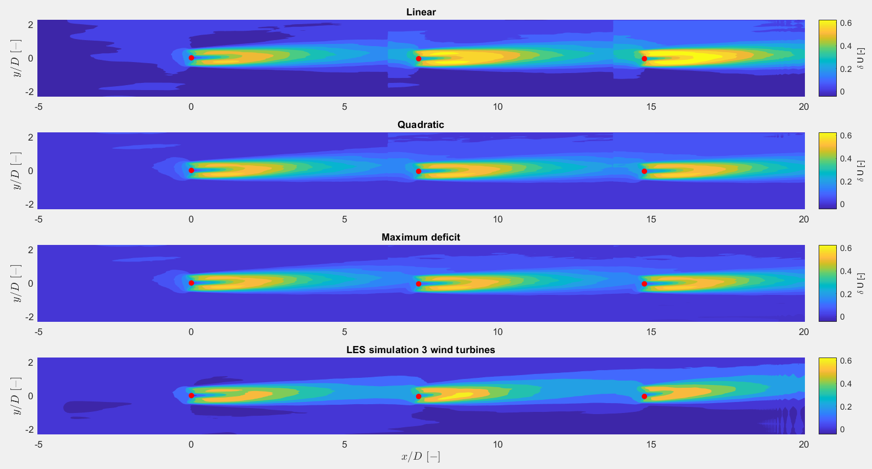
2. LES superposition (Case 3)

Slide 30
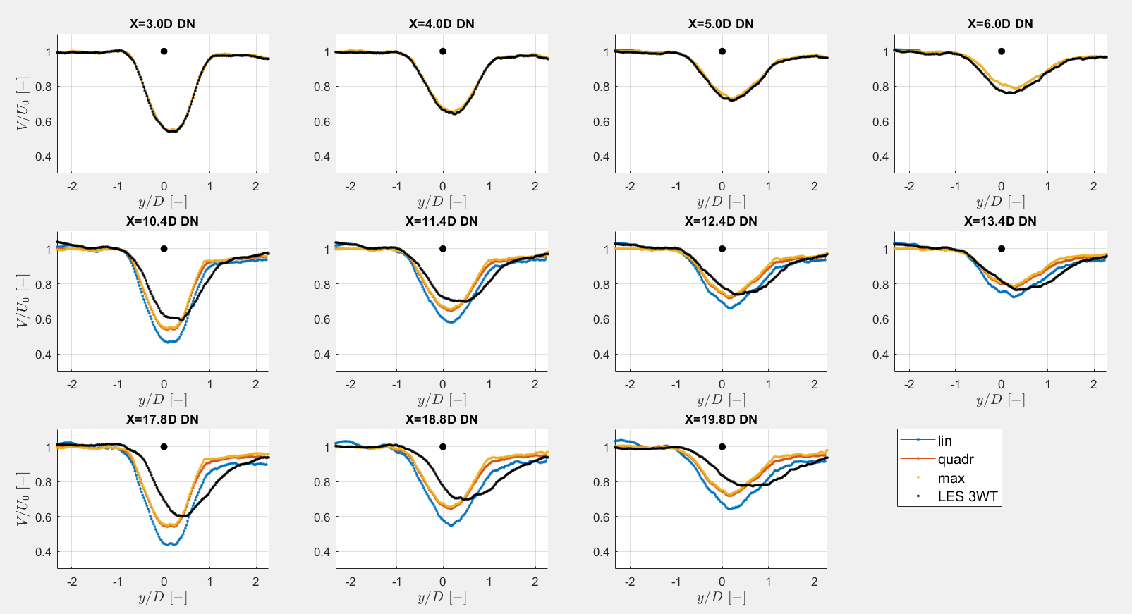
2. LES superposition (Case 3)

Slide 31
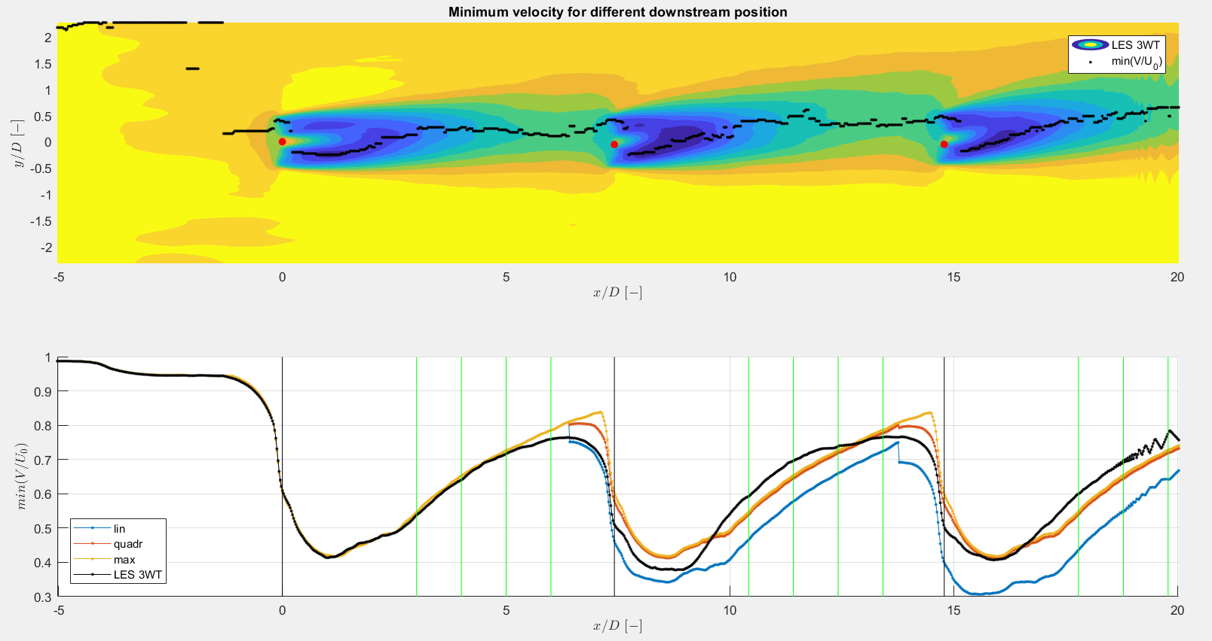
2. LES superposition (Case 3)

Slide 32
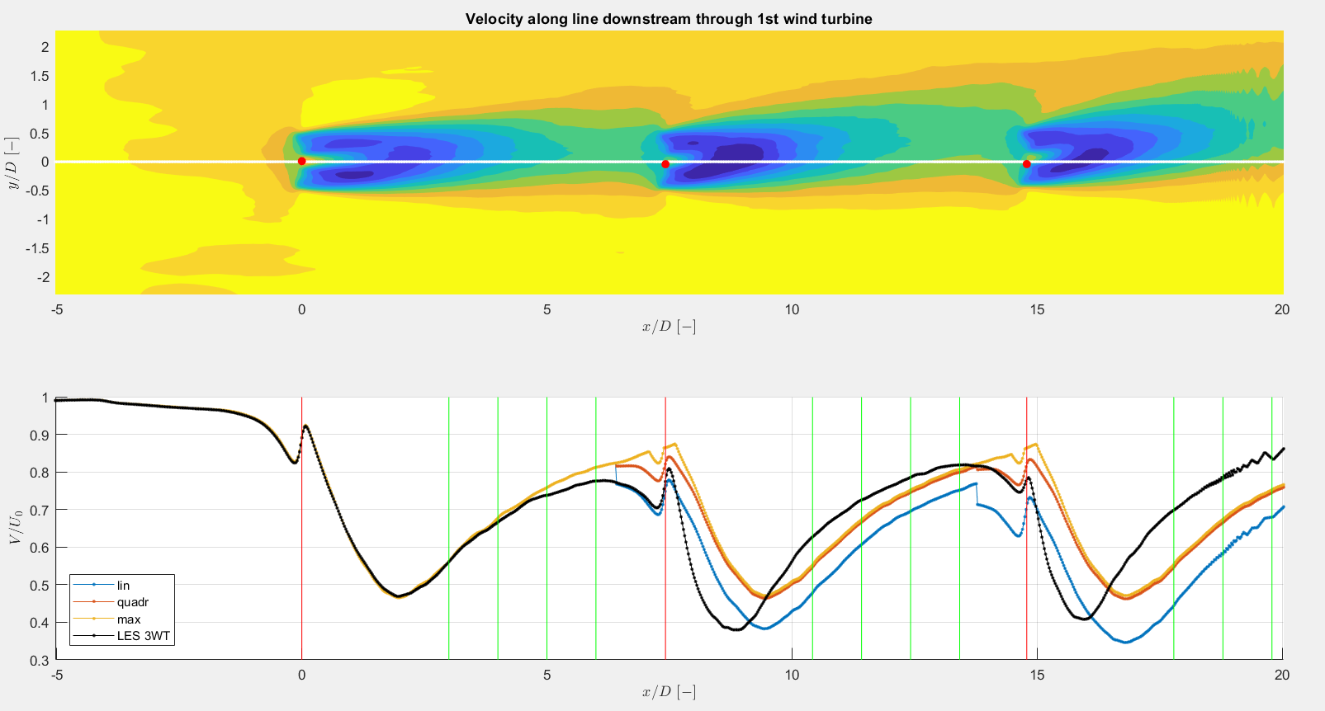
2. LES superposition (Case 3)

Slide 33
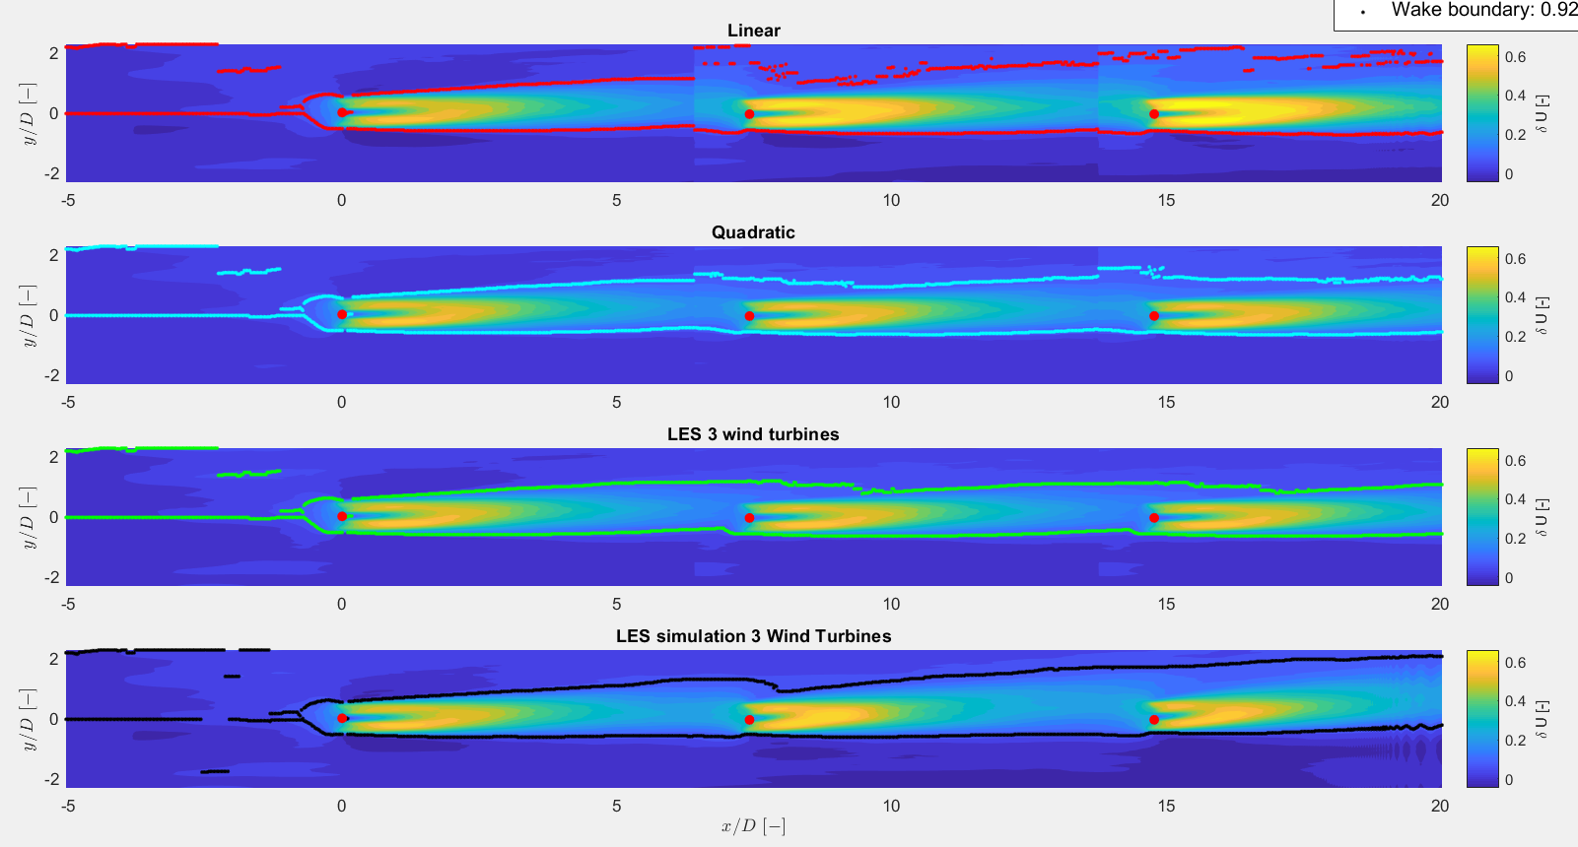
2. LES superposition (Case 3)

Slide 34
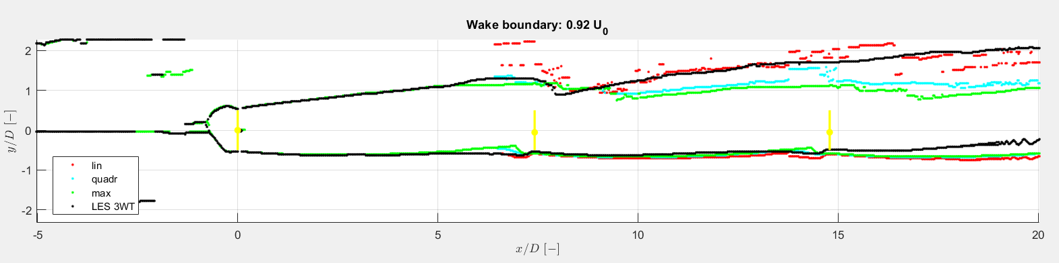
2. LES superposition (Case 3)

Slide 35
Next steps
Mid-term meeting
Interpolate LES data

